Slide 1
Reflex-based Exercise Study Using Gesture Recognition
Markiyan Varhola

Slide 2
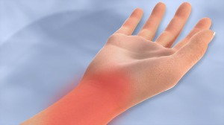
Concept
Computer users often experience hand cramps or pain
Prolonged use can cause health problems such as carpal tunnel syndrome
Can be alleviated by performing regular hand exercise.

Slide 3
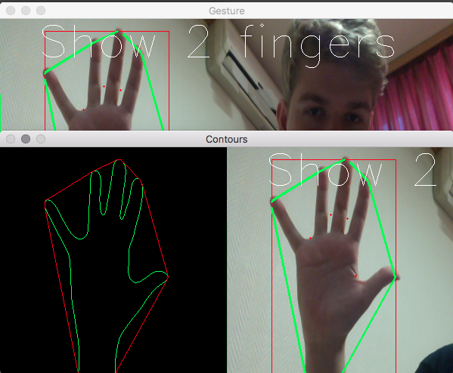
Program
Webcam-based hand gesture recognition
Present the user with an array of fingers to hold up [1,5,2,3,etc.]
Python + OpenCV implementation

Slide 4
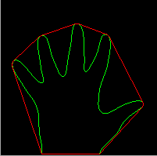
Possible User Study
Give users a warm-up exercise
Then present the user with another exercise
Measure the time difference it takes to complete the first exercise and the second

Slide 5
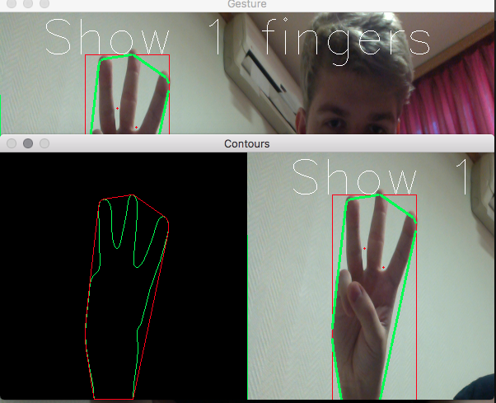
Program
Ask User Age
Start the Timer
The user must complete the tasks presented on screen
End Timer
Record result

